Slide 1
Monitoring and Understanding Notebook-Based Learning with Jupyter
A Dashboard for Student Self-Assessment
Arturo Olivares, Lisa Pawlowski

Slide 2
Introduction & Related Work
The Problem: Jupyter notebooks are central to programming education
Instructors only see the final code submissions
This hides the students' actual learning process
The Research Gap: learning dashboards primarily rely on high-level LMS metrics or focus on instructor-facing analytics
A scarcity of fine-grained, student-centered tools that visualize cell-level interactions without increasing cognitive burden.
Current Dashboard Visualizations: Existing systems range from high-level LMS metrics to advanced, coordinated Jupyter extensions for instructors. These include:
Real-time classroom monitoring: Activity heatmaps, student locations, and aggregate performance charts (bar/bubble charts for executions and time spent).
Instructor deep-dives: Cell-level visibility with execution logs and time-slider playback features for teachers to review classroom activity.

Slide 3
Methodology. Research Design
RQ1: How do students evaluate the usability of the learner-facing dashboard?
RQ2: How do students perceive the usefulness and ease of use of the dashboard?
Process
Testing the Jupyter Dashboard
Responding the Survey
Analysis using IBM SPSS Statistics

Slide 4
Methodology. Dashboard Design
Data Storage (SQLite)
(Passive, unobtrusive, real-time)
Users: personal code, role
Notebooks: title, path, author
Notebook Sessions: notebook, user, timestamps
Cells: notebook, cell type, initial content and Jupyter ID
Active Cells: cell, session, timestamps
Cell Executions: cell, session, content, timestamps, number of errors and error messages

Slide 5
Methodology. Dashboard Design
LIVE DEMO!
Data Visualization

Slide 6
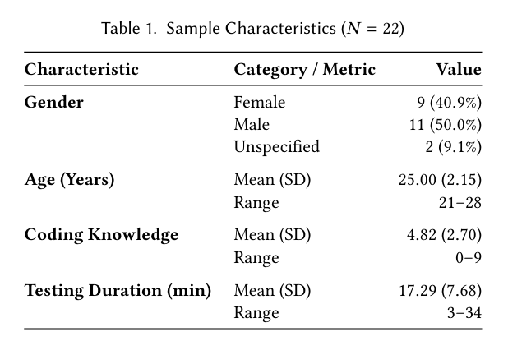
Results
Sample Characteristics

Slide 7
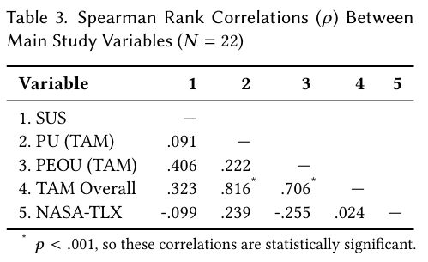
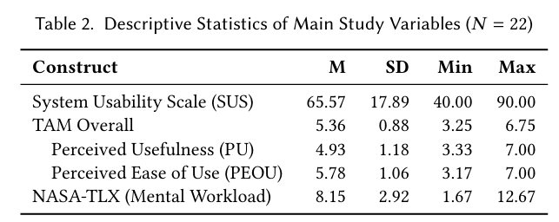
Results
Variable Characteristics

Slide 8
Discussion
Usability (RQ 1)
System Usability Scale (SUS): The mean score of 65.57 is slightly below the average benchmark of 68, indicating marginally acceptable usability.
Complexity Challenge: Integrating detailed interaction data, such as cell execution histories and error patterns, requires further UI refinement to reduce perceived complexity.
User Feedback: Students expressed a desire for tighter visual integration, such as showing error lines directly in the code and dashboard.
Layout & Cognitive Load: Vertical scrolling to access all visualizations increases the cognitive burden.
Proposed Solution: Transitioning to a single-page layout to present all summary statistics "at a glance".

Slide 9
Discussion
Usefulness & Ease of Use (RQ 2)
Discrepancy in TAM Subscales:
Perceived Ease of Use (PEOU): Rated highly (M = 5.78), showing the dashboard is intuitive and easy to navigate
Perceived Usefulness (PU): Rated more moderately (M = 4.93).
Interpretation Barrier: Students often require time and explicit instructional guidance to effectively interpret analytics feedback and recognize its metacognitive value.
"Teacher vs. Student Tool": Some participants felt the dashboard was more aligned with an instructor's perspective or pure data analysis.
Need for Actionable Guidance: Students want actionable hints on how to solve specific errors, rather than just descriptive feedback showing what they did wrong.

Slide 10
Discussion
Mental Workload (NASA-TLX)
Low Subjective Workload: The NASA-TLX yielded a mean overall score of 8.15 on a 20-point scale.
Below Global Average: When transformed to a 100-point scale (~40.75), this sits comfortably below the global median of 43.8 for user-experience meta-analyses.
Key Success: The dashboard acts as a low-workload addition to the programming environment and successfully avoids the "cognitive burden" trap.
Focus Maintained: It provides transparent execution histories without distracting learners from their primary goal of solving Python exercises.

Slide 11
Limitations & Future Work
Limitations
Sample size (only 22 participants)
Avg interaction duration (17 mins)
Future Work
Comparing students with & without dashboard
Multiple learning units to see improvement
Cell execution durations to study optimization
Database of verified solutions
Teacher dashboard
Compare students
Overall problems

Slide 12
Conclusion
Core Objective: The dashboard successfully makes the iterative, trial-and-error nature of programming transparent to learners.
Key Findings: The concept is highly viable; it is perceived as very easy to use and effectively avoids adding cognitive hurdles.
Pedagogical Needs: Unlocking the tool's full instructional value requires longitudinal engagement, pedagogical guidance, and concrete problem-solving hints.
Future Impact: Process-oriented analytics can sustainably bridge the gap between evaluating final code correctness and understanding individual learning paths.

Slide 13
Thank you for your attention!
Arturo Olivares, Lisa Pawlowski

Slide 14
References
[1] Cai, Z., et al. 2025. Jupyter Analytics: A Toolkit for Collecting, Analyzing, and Visualizing Distributed Student Activity in Jupyter Notebooks.
[2] Chu, A., et al. 2019. Usability of learning moment: features of an E-learning tool that maximize adoption by students.
[3] Corrin, L., & De Barba, P. 2014. Exploring students interpretation of feedback delivered through learning analytics dashboards.
[4] Cronbach, L. J. 1951. Coefficient alpha and the internal structure of tests.
[5] Davis, F. D., et al. 1989. Technology acceptance model: TAM.
[6] de Santana, T. L., et al. 2022. Bug Analysis in Jupyter Notebook Projects: An Empirical Study.
[7] German UPA. 2026. System Usability Scale (SUS).
[8] Groher, I., et al. 2024. A Learning Analytics Dashboard for Improved Learning Outcomes and Diversity in Programming Classes.
[9] Hart, S. G., & Staveland, L. E. 1988. Development of NASA-TLX (Task Load Index): Results of empirical and theoretical research.
[10] Hertzum, M. 2021. Reference values and subscale patterns for the task load index (TLX): a meta-analytic review.
[11] Masrom, M. 2007. Technology acceptance model and e-learning.
[12] Paulsen, L., & Lindsay, E. 2024. Learning analytics dashboards are increasingly becoming about learning and not just analytics-A systematic review.
[13] Perkel, J. M. 2018. Why Jupyter is data scientists computational notebook of choice.
[14] Project Jupyter. 2024. JupyterLab Extension Tutorial.
[15] Project Jupyter. 2024. jupyterlab/extension-template: A cookiecutter template for creating a JupyterLab extension.
[16] Robinson, D., et al. 2022. Error identification strategies for Python Jupyter notebooks.
[17] Rodriguez-Triana, M. J., et al. 2017. Monitoring, awareness and reflection in blended technology enhanced learning: a systematic review.
[18] Schwendimann, B. A., et al. 2016. Perceiving learning at a glance: A systematic literature review of learning dashboard research.
[19] Sondagar, J. J. 2021. E-Learning - Analytics using Jupyter Notebooks.
[20] Valle Torre, M., et al. 2025. JELAI: Integrating AI and Learning Analytics in Jupyter Notebooks.

